Slide 1
Intro to AI
By Ayaan Haque and Viraaj Reddi

Slide 2
Course Curriculum
Week 1: Introduction to Artificial Intelligence (AI) and Machine Learning (ML)
Week 2: AI/ML/DL Theory
Week 3: Practicing individual concepts in code
Week 4: Walking through a comprehensive project
Week 5: Getting started on individual projects
Week 6: Presenting your projects and further learning

Slide 3
Week 1: Intro to AI/ML

Slide 4
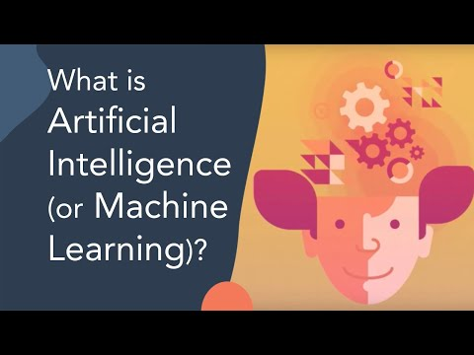
Intro Video

Slide 5
AI is everywhere
Used in: Virtual Assistants, Security, Self-driving cars, Healthcare, Medical Imaging Analysis, and more
Your phone has AI
Netflix is AI
Google searches are AI

Slide 6
What is AI?
Definition: The simulation of human intelligence in machines that are programmed to think and act like humans.
A program learns from its own results, using thousands of tests to gradually get closer to its goals
The program mimics how humans gradually learn from their surroundings by doing the same in their virtual environment
There are multiple types of AI used for different situations -- Computer Vision for understanding images, NLP for understanding human communication (e.g. speech and text), and many more

Slide 7
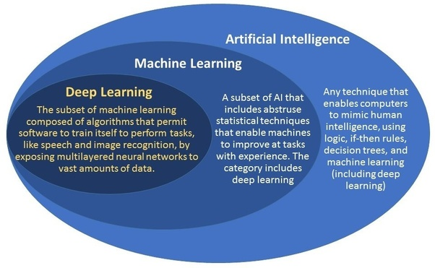
AI vs ML
AI Definition: The simulation of human intelligence in machines that are programmed to think and act like humans.
ML Definition: The practice of using algorithms to analyze data, learn from that data, and then make a determination or prediction about new data.

Slide 8
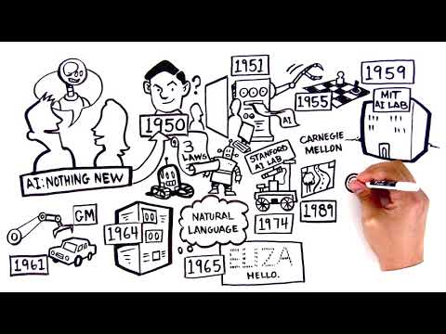
History of AI
the field of AI wasn't formally founded until 1956 at a conference at Dartmouth College, where the term "artificial intelligence" was coined.
in 1997, IBM's Deep Blue became the first computer to beat a chess champion when it defeated Russian grandmaster Garry Kasparov. And in 2011, the computer giant's question-answering system Watson won the quiz show "Jeopardy!" by beating reigning champions Brad Rutter and Ken Jennings.

Slide 9
Types of AI
Computer Vision: https://machinelearningmastery.com/what-is-computer-vision/
NLP: https://machinelearningmastery.com/natural-language-processing/
Recommendation Systems: https://developers.google.com/machine-learning/recommendation/collaborative/basics
Deep Learning: https://machinelearningmastery.com/what-is-deep-learning/

Slide 10
Practical Applications of AI
AI is extensively used in:
Healthcare: https://www.forbes.com/sites/bernardmarr/2018/07/27/how-is-ai-used-in-healthcare-5-powerful-real-world-examples-that-show-the-latest-advances/#3dd5aeb95dfb
Sustainability: https://www.youtube.com/watch?v=mJ6rjJiIHyo
Business: https://www.youtube.com/watch?v=N_eHmaRf9T4
Economics: https://www.youtube.com/watch?v=0BAFOJbo4W4

Slide 11
Ethics of AI
There is very little regulation surrounding AI considering how new it is, but there are various ethical questions about how far to take this technology
Stanford article summarizing ethics of AI
Big questions:
How can we ensure a right to privacy and knowledge of surveillance?
Will AI ever be able to do things on its own?
Far reached example, but think Ultron from Avengers

Slide 12
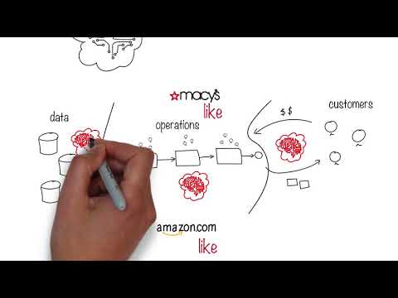
Video -- Ethics of AI(How it hurts employees)

Slide 13
How AI will help you
College Applications:
Potential Major in CS, Engineering
Then AI will be very useful
There's no AI/ML major yet, but it might be a thing in the future
AI is the future in careers:
Every career is gradually integrating AI, and developing a foundation in AI will assist you wherever you choose to go
Regardless of what you want to pursue, AI will most likely be important
Viraaj wants to be a doctor, but he still learns AI because of its vast potential and application in healthcare

Slide 14
Setting up google colaboratory
Google colab: A free integrated development environment (IDE) hosted by Google that allows you to run your Python code
Ayaan will screen-share and show you how to set this up in your Google Drive

Slide 15
Learning Github
We will be using Github as our primary source of storing and sharing code and materials for this course
All of you should make Github accounts and we will teach you how to share your code on github using Github Desktop.
All of you should make your own repository where you will make a folder for your practice code as well as a folder for your actual project when you make it

Slide 16
HW: Python Brush Up
General python reference center: https://www.w3schools.com/python/

Slide 17
Questions?

